Slide 1
Workshop Preview - Understanding AI: A Forum for Local & Tribal Governments February 25, 2026
Bill Oemichen, J.D. John Parrish
Professor of Practice – Law Community Economic Development Specialist
Local Government Education Program Community Development Institute
U.W.-Madison Division of Extension U.W.-Madison Division of Extension

Slide 2
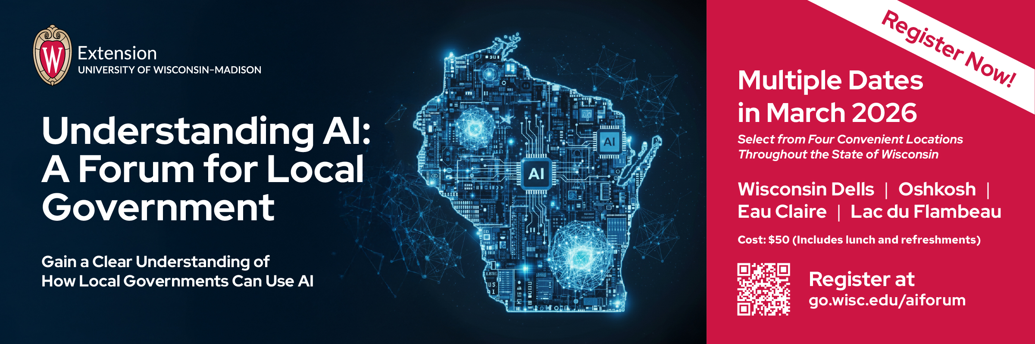

Register for the full program:

Slide 3

Presentation Roadmap
Understanding AI
Practical AI Applications for Local Government
AI Use Risks/Mitigation Strategies
AI Security and Privacy
Reflection

Slide 4
Understanding AI

Slide 5
Artificial Intelligence 101
AI refers to computer systems that can perform tasks typically requiring human intelligence.
Think of AI as a spectrum of capabilities, from simple to complex:
Rule-based systems (like traffic lights)
Pattern recognition (spam filters)
Machine learning (recommendation systems)
Advanced language processing (ChatGPT, Claude)

Slide 6
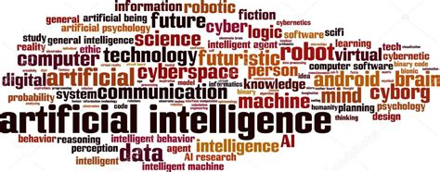
Artificial Intelligence
AI has been used for decades
Generative models have been used since 2010
Generative AI (GPT 3) has been available since 2020
GPT 4 available since March 2023
GPT 5 available since August of 2025
Generative AI is a conversational AI that helps with:
Generating insights
Brainstorming ideas
Summarizing complex topics
May be used for:
Policy analysis
Topical research
Community engagement
Grant proposal identification and development
Presentation preparation

Slide 7

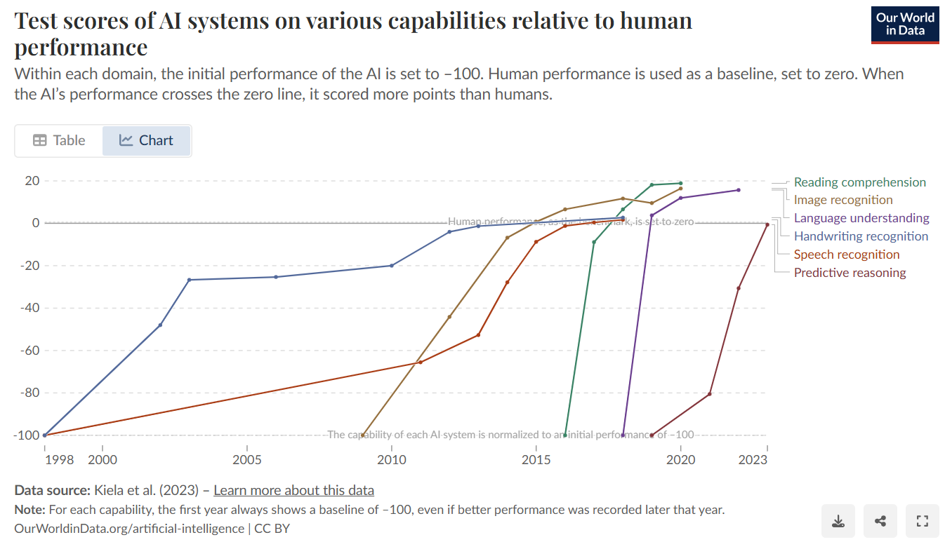

Slide 8
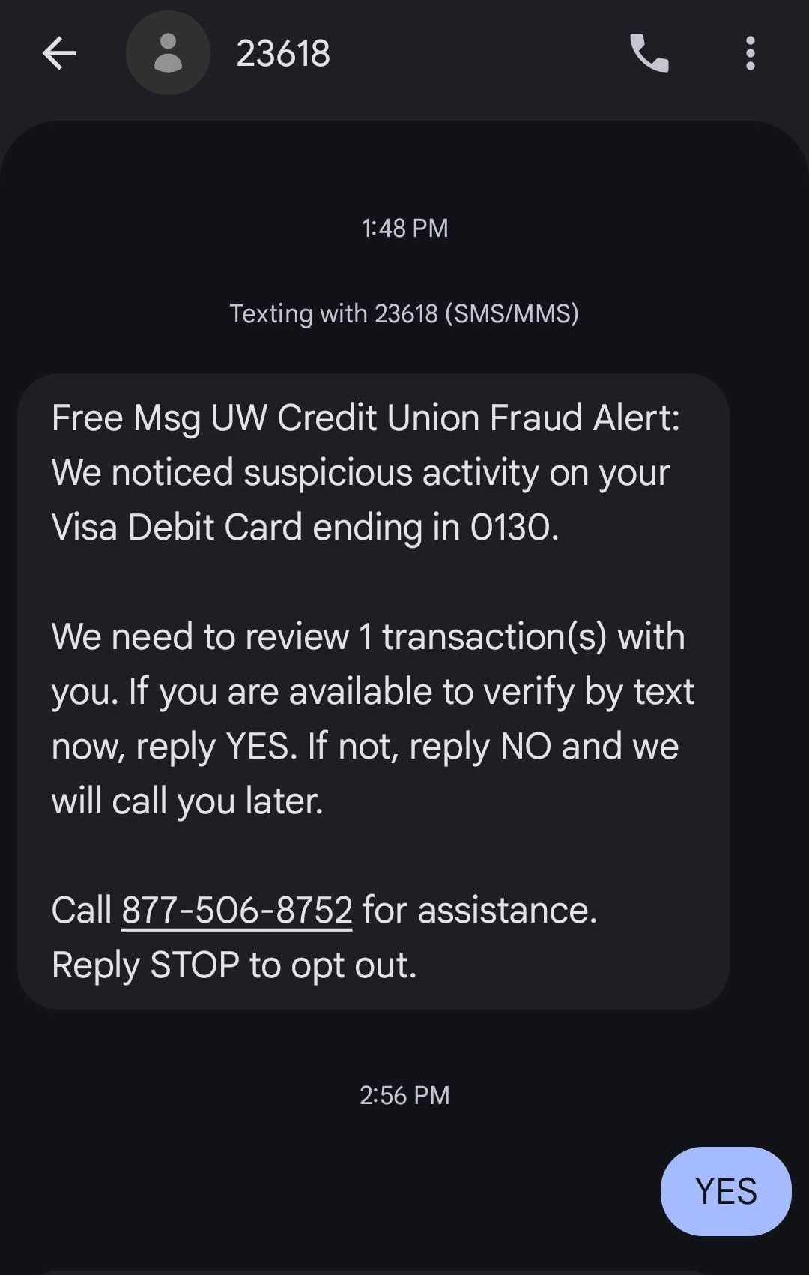
AI in Your Life Today
Email spam filters
Online shopping recommendations
Fitness trackers
Social media feeds
Music streaming
Navigation
Ride-sharing apps
Email/text predictive writing
Image recognition

Slide 9
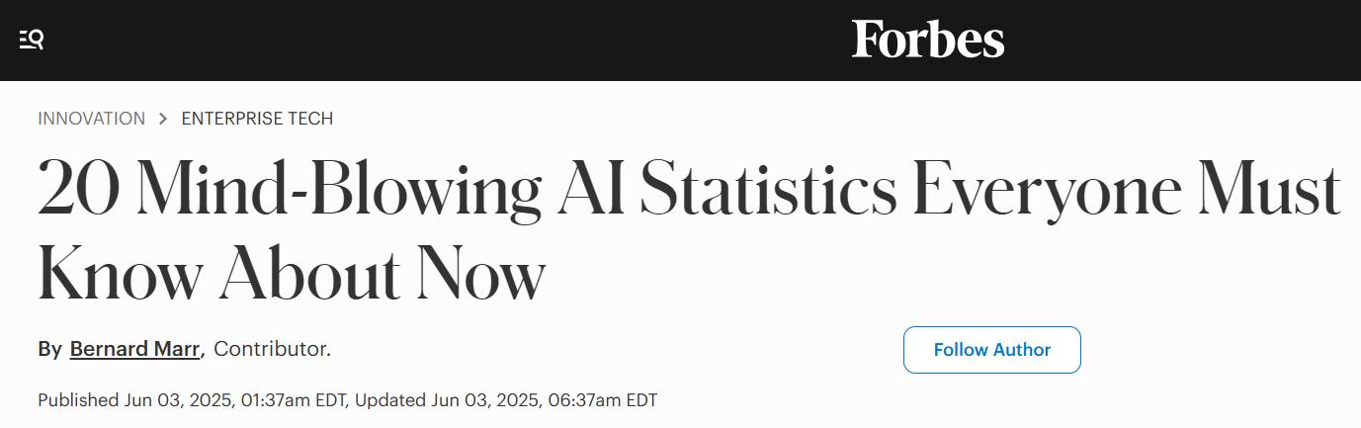
92% of students use generative AI; up from 66% in 2024
46% of Americans trust AI
78% of American organizations use AI; up from 55% in 2024
66% of people regularly use AI
Notes:
Hand it off to Bill to talk about the use of AI in counties AND risk considerations

Slide 10
Practical Applications Local Government

Slide 11
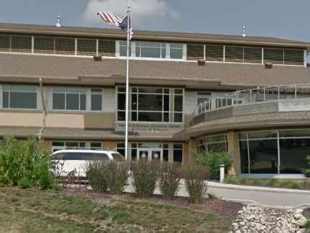
AI Benefits to Local Government
Providing constituent information and education
Enhancing policy setting
Improving service delivery
Improving health and safety regulatory processes
Increasing financial resources
Expanding program analysis and evaluation

Slide 12
AI Use in Local Government
Generative AI
Writing reports
Writing grant applications
Reviewing permit applications
Creating agendas/notices
Drafting resolutions/ordinances
Reviewing and writing e-mails
Obtaining “expert” opinion
General AI
Reviewing law enforcement bodycam footage
Streamlining open records requests
Creating automated alerts
Transcribing/analyzing meetings
Timing smart traffic lights
Assessing property through 3D imaging
Predictive modeling

Slide 13
AI Use Risks & Mitigation Strategies

Slide 14

Primary AI Risks:
Privacy violation
Incorrect information
Bias
Copyright infringement
Poor quality
Image generated by Adobe Firefly, prompted by Megan Poindexter
Notes:
Privacy Violation
The problem: AI can be a black hole…we don’t always know how our inputs are incorporated into the model.
The solution: mitigate the risk of privacy violations from AI by:
Never sharing sensitive data or documents with AI
Incorrect Information The problem: Incorrect/false information Example: False court case citations
The solution: Always fact checking AI, citing official sources, knowing that you are responsible for the work you produce (not AI)
CopyRight infringement
The problem: Image generation using original sources
The solution: Fact-checking and finding original sources, Using AI-generated images carefully
Bias:
Training data bias: reflect viewpoints towards certain regions
Cultural bias: reflect Western norms; misrepresent cultural diversity
Gender bias: reflect gender stereotypes (doctors vs. teachers)
Racial and ethnic bias: perpetuate stereotypes or underrepresent minority perspectives
Confirmation bias: response may align with user’s inputs
Political bias: may favor certain political perspectives
Socioeconomic bias: may reflect more affluent societies or classes
Accessibility bias: underrepresent less mainstream info sources
Language bias: AI models perform better using English
Recency bias: may favor most recent information
Always fact check AI
Cite an official source
Think about potential unintentional biases in word choice or arguments that may be present in the tool response
Know that you are responsible for the work you produce (not AI)
Use AI platforms/vendors with more diverse data sources
Poor Quality
The problem: have you ever spent an hour on ChatGPT working on a paragraph and ultimately trashed the result to rewrite it yourself? You are not alone!
The solution: mitigate the risk of poor-quality outcomes from AI by:
Using prompting techniques to improve outputs
Using AI as a first draft, not a final draft
Engaging your critical thinking skills

Slide 15
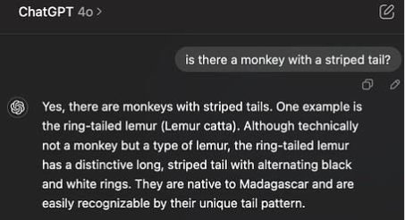
True vs New
“The AI is not pulling from a database; it is guessing the next word based on statistical patterns in its training data. That means that what it produces is not necessarily true … even when it provides false information, it likely sounds plausible. That makes it hard to tell when it is making things up.”
-Ethan Mollick, Professor and Co-Director of Generative AI Labs at Wharton

Slide 16
Beware of AI Bias Risk
Training data bias: reflect viewpoints towards certain regions
Cultural bias: reflect Western norms; misrepresent cultural diversity
Gender bias: reflect gender stereotypes (doctors vs. teachers)
Racial and ethnic bias: perpetuate stereotypes or underrepresent minority perspectives
Confirmation bias: response may align with user’s inputs
Political bias: may favor certain political perspectives
Socioeconomic bias: may reflect more affluent societies or classes
Accessibility bias: underrepresent less mainstream info sources
Language bias: AI models perform better using English
Recency bias: may favor more recent information

Slide 17

Potential AI Bias and Copyright Violation
What do you notice about this image that was created using the following prompt:
Please provide me with a photo of University of Wisconsin Extension teammates celebrating the success of a project

Slide 18
AI Risk Mitigation
Privacy violation – avoid sharing sensitive information
Incorrect information – carefully review and fact check AI- generated content
Know that you -- not AI -- is responsible for your work
Copyright infringement – fact check information and cite original sources
Bias – use critical thinking and peer review
Poor quality – put thinking time into developing prompts and don’t expect AI to do all the work

Slide 19
Developing AI Use Policies and Training Programs
Use Policies
üDefine who may use AI in their work
üIdentify training thresholds for use
üIdentify types of training required
üDefine which AI platforms may be used/not used
üIdentify appropriate security settings
üDefine whether and to what extent employees may use AI outputs
üDefine data types prohibited from use in prompts
üDefine discipline process for failure to follow policy
Training Programs
Develop training programs focused on:
What is AI
How AI can be deployed to benefit governmental operations and improve constituent service
AI risks and mitigation strategies
Security and privacy
AI use policy compliance

Slide 20
AI Security and Privacy

Slide 21
AI Security and Privacy
Data Security
Purchase “Enterprise Chat” AI bot b/c/ enterprise chat versions will not use your data for training
UW: Microsoft CoPilot & Google Gemini Enterprise Chat Versions
$30/user per month
Don’t use confidential information in prompts
Data can be used to train the model
Data is then available to others
Anonymize data
Data Privacy
Don't use AI bots at home for governmental business
If using ChatGPT or another bot at home for personal purposes:
When opening an AI account, go to settings and select “no” to question allowing data to be used for training
ChatGPT will still save data for thirty days but will not share
AI prompts may be subject to disclosure under Public Records Law

Slide 22

Employee AI Use Policies: Risk Sorting
Sorting framework to set employee boundaries
Green Light: use of AI is acceptable
Routine administrative tasks
Drafting meeting minutes/social media posts
Preparing e-mail drafts
Yellow Light: use of AI depends on checking the work to check for accuracy due to hallucinations/bias
Writing grants
Analyzing data
Red Light: not applicable b/c task involves significant risk of public disclosure
Analyzing confidential economic development files
Analyzing personnel records
Writing reports on veteran mental health

Slide 23
Reflection

Slide 24
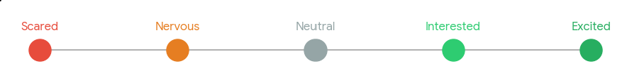
Time for Reflection
How do you feel about using AI in your:
Governmental work?
Personal life?
How will you use AI in the next week? Month?
What steps will you take to protect data privacy and security?

Slide 25






Acknowledgements
Southwest Regional Planning
Iowa County Government
Bayfield County Government
University of Wisconsin School of Business

Slide 26
Register for the full program:

